Slide 1
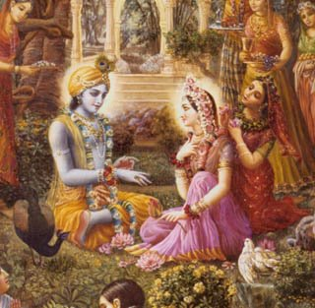
Upadesamrta

Slide 2
TEXT ONE
väco vegaà manasaù krodha-vegaà
jihvä-vegam udaropastha-vegam
etän vegän yo viñaheta dhéraù
sarväm apémäà påthivéà sa çiñyät

Slide 3
A sober person who can tolerate the urge to speak, the mind’s demands, the actions of anger and the urges of the tongue, belly and genitals is qualified to make disciples all over the world.

Slide 4
VERBAL
WORDS
MENTAL
MIND
ANGER
PHYSICAL
TONGUE
BELLY
GENITAL

Slide 5
Alternative Classification
Mental
Desire , Anger
Sensual
Tongue , eye, ear, nose, skin
Physical
Voice, genital, belly anus, hands, feet

Slide 6
Belly is also a sense organ
When the universal form desired to take in food and drink his location of the abdomen, the sense organs in the form of the intestines and veins, their devataa the rivers and oceans, and their sense objects, fullness from food and fullness from liquids, which take shelter of the sense organs and their devatas, appeared. SB 2.10.29

Slide 7
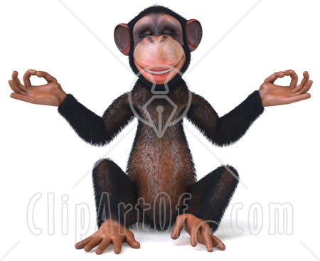

UNCONTROLLED
SENSES
CONTROLLED
SENSES

Slide 8
Sense Control as Anga of Sadhana
Karma-yoga
Sense control
Jnana -yoga
Sense control
Study
Vows
Occupational duties
Worship of devatas
Bhakti-yoga
Hearing
Chanting
Worshipping Krsna
Material happiness
Liberation
Prema

Slide 9
Accepting Favorable
Bhakti-yoga
Hearing
Chanting
Worshipping Krsna
Prema
Rejecting Unfavorable –controlling Vegas

Slide 10
Elements of Surrender
atma nivedana
Krsna is maintainer
Accepting favorable
Rejecting unfavorable
Krsna is protector
Humility

Slide 11
Bhakti-yoga
Primary Rules
Hearing
Chanting
Worshipping Krsna
Prema
Secondary Rules
Rules of Varnasrama:
body—cleanliness
mind—concentration—yoga
social interaction—family
and caste rules

Slide 12
Secondary Rules
Rules of Varnasrama
body—cleanliness
mind—concentration—yoga
social interaction—family and caste
rules
Sattva guna

Slide 13
Mind
Manasa vega
Desire for objects:
Enjoyment, liberation, siddhis
Krodha vega
Obstruction to enjoyment:
Anger, hatred, harsh words

Slide 14
Expectation of enjoyment
Anger

Slide 15
Senses--Jnanendriya
Tongue
tasting
Eye
seeing
Ear
hearing
Nose
smelling
Skin
touching

Slide 16
Body --Karmendriya
Belly
Overeating
Causing sickness, laziness
Genital
Breaking rules of asrama for
Brahmacari, grhastha, vanaprastha, or sannyasi
Voice
Speaking impersonalism, karma yoga,
sinful enjoyment, violence

Slide 17
Bhakti-yoga
Hearing
Chanting
Worshipping Krsna
Prema
Attachment
Vega
10th Aparadha

Slide 18
Control
Desire,
Anger
Tongue, eye, ear, nose, skin
Voice, belly, genital, hands, feet, anus
Mental
Sensual
Physical

Slide 19
TEXT TWO
atyähäraù prayäsaç ca
prajalpo niyamägrahaù
jana-saìgaç ca laulyaà ca
ñaòbhir bhaktir vinaçyati

Slide 20
Unfavorable to Bhakti
Overeating, over endeavor, over talking, rejection of rules, bad association and unsteadiness destroy bhakti.

Slide 21
Uncontrolled Vedas lead to the items listed in verse 2
Vega
Destructive Elements

Slide 22
Desire
Over endeavor
Anger
Rejection of rules
Senses-tongue
Unsteadiness, passion
Voice
Belly
Genital
Over talking
Over eating
Association with women

Slide 23
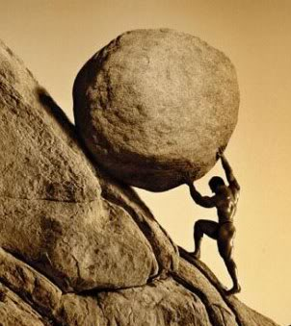
Prayasa:
wrong endeavors or actions
because of strong desires:
undergoing difficulties (study, meditation) to achieve goals of liberation
undergoing tapas, execution of rituals for enjoyment
work for family, properties etc. gross objects
From manasa vega

Slide 24

Niyamagraha
not following any rules for controlling senses and bhakti
from krodha vega

Slide 25
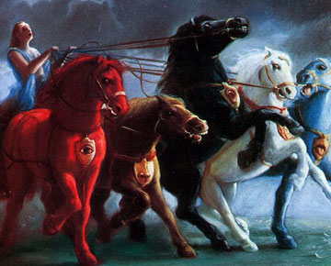
Laulyam
Unsteadiness:
dedicating life to liberation, svarga and present material assets, instead of devotion
Passion, uncontrolled senses
From Jihva vega: uncontrolled senses
this can lead to aparadha of worship of devatas etc.

Slide 26
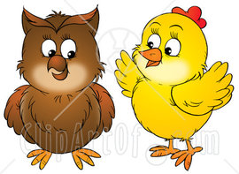
Prajalpa
talking scripture to defeat others by learning, discussion
study of rituals for material elevation,
useless talk to please the senses
From vacovega
this can lead to aparadha of sadhu ninda

Slide 27
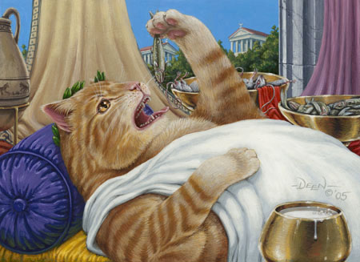
            Atyahara:
Over-enthusiasm for material accumulation
or overeating
From udara vega

Slide 28
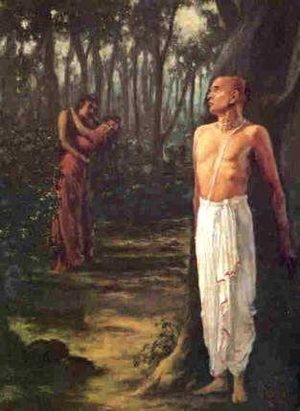
Jana sanga
association with jnanis, karmis and materialists,
illicit sex life
upastha vega

Slide 29
TEXT THREE
utsähän niçcayäd dhairyät
tat-tat-karma-pravartanät
saìga-tyägät sato våtteù
ñaòbhir bhaktiù prasidhyati

Slide 30
Favorable Items
Bhakti is nourished by enthusiasm, conviction, gravity, following rules previously rejected, giving up bad association and following proper conduct.

Slide 31
Controlled Vega
Favorable Elements

Slide 32
Uncontrolled Vega Controlled
Over endeavor prayasa | Desire manasa vega | Conviction niscaya
Rejection of rules niyamagraha | Anger krodha vega | Follow rules karma pravartana
Unsteadiness laulyam | Tongue jihva vega | Follow proper conduct sad vrtti
Over talking prajalpa | Voice vaco vega | Gravity dhairya
Over eating Atyahara | Belly udara vega | Enthusiasm for bhakti utsaha
Bad association Jana sanga | Genital upastha | Avoid bad association sanga tyaga

Slide 33

Attitudes Favorable to Bhakti
Utsaha:
to practice the angas of bhakti with enthusiasm, indifferent to jnana, ,karma goals
Counter acts atyahara – accumulation of goods or food

Slide 34

Niscaya
to practice with great faith and conviction that bhakti is the only path
Counteracts prayasa—over endeavor for material goals.

Slide 35

Dhairya
Gravity: devotee remains serious about his practice
This counter acts over talking (prajalpa) or other uncontrolled physical functions

Slide 36
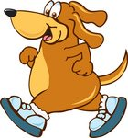
Karma pravartana
Observing vidhi and nisedha according to scripture, following the angas of bhakti, indifferent to the processes of jnana, karma material life
This counteracts tendency to reject rules (niyamagraha).

Slide 37
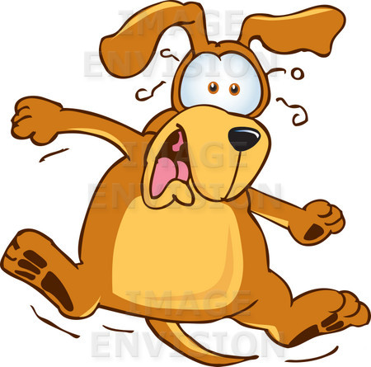
Sanga tyaga:
Sanga tyaga:
Avoid association with woman illicitly
Association with a person controlled by a woman
Association with a person who is associating with women illicitly,
Association with non devotees, mayavadis, atheists, pretenders
This counter acts bad association --jana sanga

Slide 38

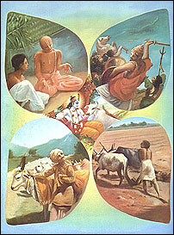
Sad vrtti
Supporting ones body as much as necessary, ethically, according to varnasrama rules., following according to ones qualification as grhastha, brahmacari without deviating from bhakti etc.
This counteracts unsteadiness and lack of sense control

