Slide 1
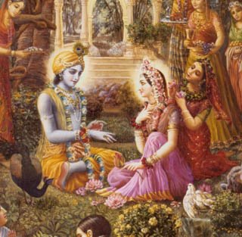
Upadesamrta

Slide 2
TEXT FOUR
dadäti pratigåhëäti
guhyam äkhyäti påcchati
bhuìkte bhojayate caiva
ñaò-vidhaà préti-lakñaëam

Slide 3
Six Symptoms of Affection between Devotees
Six types of affection are giving and receiving gifts, giving and receiving knowledge, giving and receiving food.

Slide 4
Sat Sanga Good Association
Main Anga of Bhakti
Five Major Activities of Bhakti:
Hearing
Chanting
Worshipping
Association
Living in Vrndavana

Slide 5
Association is the Cause
Association
Hearing
Chanting
Worshipping
Living in Dhama

Slide 6
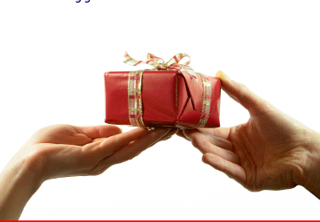
Sat Sanga Good Association
Offering gifts
Accepting gifts

Slide 7

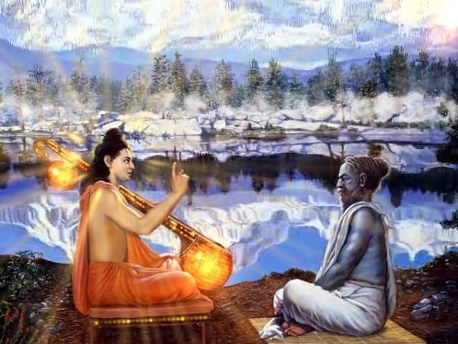
Revealing Knowledge
Receiving knowledge

Slide 8
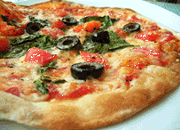
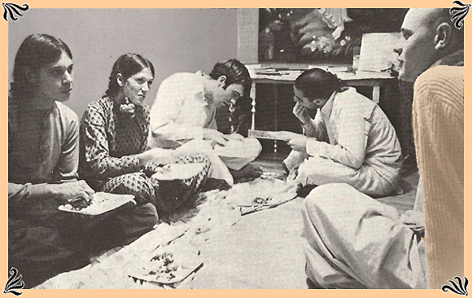
Giving prasäda
Receiving prasäda

Slide 9
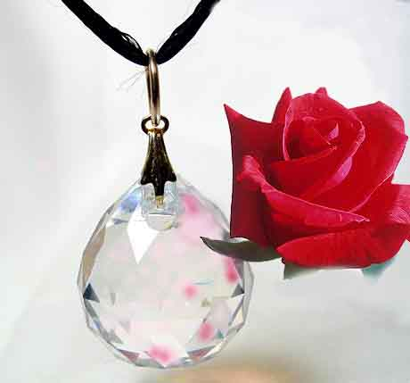
One should not give or receive things, teachings, or food from asat people. This will increase affection for them. As ones affection increases one will develop similar qualities.
One should instead increase affection for those immersed in bhakti, by exchange of objects, teachings and food.

Slide 10
TEXT FIVE
kåñëeti yasya giri taà manasädriyeta
dékñästi cet praëatibhiç ca bhajantam éçam
çuçrüñayä bhajana-vijïam ananyam anya-
nindädi-çünya-hådam épsita-saìga-labdhyä

Slide 11
Conduct of the Madhyama Devotee
He should mentally honor the devotee who chants the holy name of Lord Krsna (the kanistha devotee).
He should offer humble obeisances to the devotee who has undergone spiritual initiation and is engaged in worshiping the Deity (the madhyama devotee),
He should associate with and faithfully serve that devotee who is skilful in worship and whose heart is completely devoid of criticizing others. (uttama devotee)

Slide 12
Types of Devotee
Kanistha
Accepts the name as Krsna
prabhu kahe yahra mukhe eka krsna nama
sei to vaisnava kariha tahara sammana
He who chants the name once is a Vaisnava.

Slide 13
arcayam eve haraye pujan
yah sraddhayehate
na tad bhaktesu canyesu
sa bhaktah prakrtah smrtah
The devotee who worships the Lord with faith but does not have faith in the devotees is a kanistha.
Nama abhasa—no association

Slide 14
Madhyama Bhakta
Accepts the name as Krsna
Chants continuously
Worships Krsna with sambandha jnana
Avoids asat sanga
Teaches the innocent
Associates with devotees
Honors guru and takes diksa

Slide 15
krsna nama nirantara yanhara vadane
se vaisnava srestha bhaja tanhara carane
The vaisnava who constantly chants is the best and one should worship his feet, offering obeisances.

Slide 16
isvare tad adinesu
balisesu dvisatsu ca
prema maitri krpopeksa
yah karoti sa madhyamah
The Madhyama worships the Lord with devotion, shows friendship to madhyama devotees, shows mercy to kanisthas, and avoids the non-devotees.

Slide 17
Diksa
divyam jnanam yato dadyat
kuryat papasya samksayam
tasmad dikseti sa prokta
desikas tattvakovidaih
ato gurum pranamyaiva
sarvasvam vinivedya ca
grhniyad vaisnavam mantram
diksapurvam vidhanatah

Slide 18
Diksa is so-called by the wise because it bestows divya jnana and destroys sins.
Di (vya-jnana) + ksa (yam papasya)
Therefore one should offer respects to guru, offer him everything and accept Vaisnava mantra according to the rules while taking diksa.

Slide 19
divyaà jïänaà hy atra çrémati mantre bhagavat-svarüpa-jïänaà, tena bhagavatä sambandha-viçeña-jïänaà ca | yathä pädmottara-khaëòädäv añöäkñarädikam adhikåtya vivåtam asti ye tu sampattimanto gåhasthäs teñäà tv arcana-märga eva mukhyaù |
Divya jnanam is knowledge of the form of the Lord and knowledge of ones particular relationship with the Lord in that sacred mantra.
It is mainly for rich householders doing deity worship. Bhakti sandarbha

Slide 20
Diksa
Spiritual knowledge
Destruction of sin, desires etc.

Slide 21
Diska
Mantra
Divya Jnana
Destruction of sin
Knowledge of Form of Lord
Knowledge of Relationship with Lord

Slide 22
Diksa and Nama
Diksa: mantra, Arcana marga
Nama: no diksa, sambandha jnana , Bhagavata marga, yuga dharma

Slide 23
Because of the fickle mind of the devotee, arcana marga is often recommended along with bhagavata marga to engage all his senses in deity worship along with chanting the name.

Slide 24
Madhyama
Nama: main sadhana, always chants
Mantra: for deity worship

Slide 25
PANCARATRA
MARGA
ARCANA
BHAGAVATA
MARGA
NAMA
KIRTANA
MANTRA
SIKSA
DIKSA

Slide 26
Diksa Panca Samskara
Vaisnava Diksa
TILAKA
TAPA (BRANDING)
KRSNA DAS
KRSNA MANTRA
ARCANA

Slide 27
Vaidic Diksa
UPANAYANA SAMSKARA
SACRIFICE
VEDIC GAYATRI MANTRA

Slide 28
Diksa Panca Samskara
Vaisnava Diksa + Vaidic Diksa
TILAKA
TAPA (BRANDING)
KRSNA DAS
KRSNA MANTRA
ARCANA
VEDIC GAYATRI
DVIJA SAMSKARA

Slide 29
Uttama
yanhara darsane mukhe aise krsna nama
tahare janiha tumi vaisnava pradhana
The best devotee is he makes one chant Krsna’s name.
Always absorbed in chanting the name.

Slide 30
sarvabhutesu yah pasyed
bhagavad bhavam atmanah
bhutani bhagavaty atmany
esa bhagavatottamah
The highest devotee engages only in internal worship of Krsna, seeing no distinctions, with no hatred of others.

Slide 31
Conduct of the Madhyama Devotee
He should mentally honor the devotee who chants the holy name of Lord Krsna (the kanistha devotee).
He should offer humble obeisances to the devotee who has undergone spiritual initiation and is engaged in worshiping the Deity (the madhyama devotee),
He should associate with and faithfully serve that devotee who is skilful in worship and fully devotees and whose heart is completely devoid of the propensity to criticize others. (uttama devotee)

Slide 32
Madhyama
Uttama
Madhyama
Kanistha
Madhyama
Service to Superior
Instructions to Inferior

Slide 33
TEXT SIX
dåñöaiù svabhäva-janitair vapuñaç ca doñair
na präkåtatvam iha bhakta janasya paçyet
gaìgämbhasäà na khalu budbuda-phena-paìkair
brahma-dravatvam apagacchati néra-dharmaiù

Slide 34

Avoiding Sadhu Ninda
The devotee should not see another devotee as a material being, seeing faults in his body or faults produced by karma and his nature. The spiritual nature of the Ganga is not dissipated if the water is contaminated by foam, bubbles or mud.

Slide 35
Respecting Vaisnava
Respect
Sympathy
Spiritual Knowledge
Mercy
Realization

Slide 36
Vaisnava Aparadha
Disrespect
Knowledge
Mercy
Realization

Slide 37

Seeing bodily defects
Seeing material birth
Seeing his sinful activities before his devotional life
Seeing traces of bad qualities at present
Dwelling on accidental sins committed at present.

Slide 38
TEXT SEVEN
syät kåñëa-näma-caritädi-sitäpy avidyä-
pittopatapta-rasanasya na rocikä nu
kintv ädaräd anudinaà khalu saiva juñöä
svädvé kramäd bhavati tad-gada-müla-hantré

Slide 39


Though the holy name, character, pastimes and activities of Krsna are all sweet the tongue of one afflicted by the jaundice of ignorance cannot taste its sweetness.
By carefully chanting these sweet names every day, a natural relish gradually develops, and his disease is destroyed at the root.

Slide 40
Cultivating a Taste for the Name
VERSE 3
KARMA PRAVARTANA
VERSE 4, 5
ASSOCIATING WITH DEVOTEES
VERSE 6
AVOIDING VAISNAVA APARADHA
VERSE 1-3
CONTROL VEGAS, AVOID UNFAVORABLE ,
ACCEPT FAVORABLE VERSE 1, 2, 3
TASTE FOR THE NAME

Slide 41
The devotees performing sadhana bhakti should always be attentive to the condition of their devotion, perceiving the state yesterday and the improvement made today. If he perceives that after some days no progress has been made according to the stages given above, he must understand that some offense must have been committed. Having diagnosed that offense, he should give up that offense and correct the harm done, by associating with devotees.

Slide 42





