Slide 1
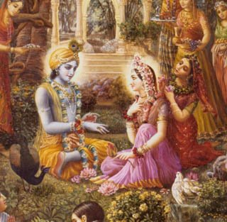
Upadesamrta 3

Slide 2
TEXT EIGHT
tan-näma-rüpa-caritädi-sukértanänu-
småtyoù krameëa rasanä-manasé niyojya
tiñöhan vraje tad-anurägi janänugämé
kälaà nayed akhilam ity upadeça-säram

Slide 3
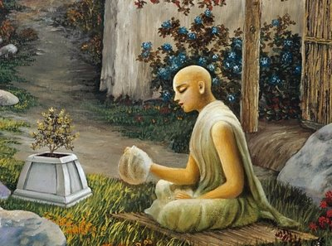
One should spend all one’s time engaging the mind and tongue in remembering and glorifying Krsna’s name, form and pastimes, living in Vraja, and in following in the footsteps of the great devotees, with great love for Krsna.

Slide 4
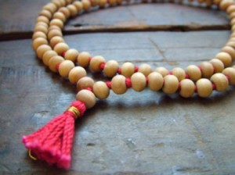
Raganuga Sadhana
Continual chanting –external service
Remembrance of Lord and his pastimes –internal service

Slide 5
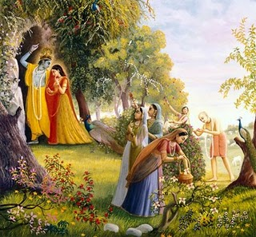
Internal Service
Remembrance of Lord and his pastimes –

Slide 6
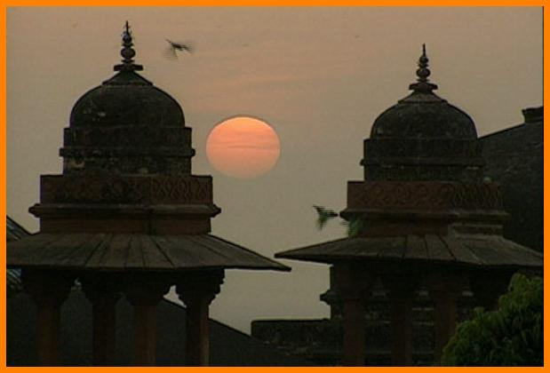
Living in Vraja

Slide 7
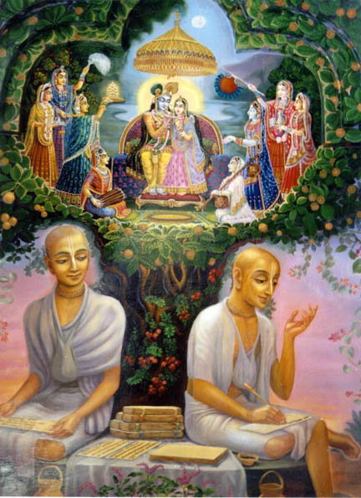
Following in the footsteps of the Vrajavasis.
Cultivating dasya, sakhya vatsalya or madhurya rasa.

Slide 8
Stages of Raganuga--Sadhana
Sravana dasa hearing:
hears instructions on sadhana and sadhya,
chants without offense, continuously
Varana dasa acceptance
  chanting purely,
  detailed instructions on worshipping mentally in siddha rupa

Slide 9
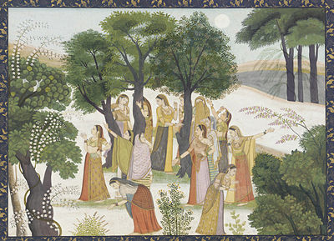
Smarana dasa remembering daily pastimes of Krsna, mind wanders
  Dharana : no wandering of mind
  Dhyana: full engagement of mind
  Anusmrti: constant dhyana
  Samadhi: complete absorption

Slide 10
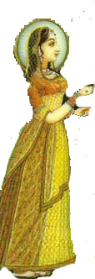
Bhava and Prema
Apana dasa
  svarupa siddhi serving in spiritual body while maintaining material body
  Realiziation of name, form, qualities, pastimes and rasa
Sampatti (prapana)dasa or vastu siddhi attaining spiritual body in spiritual world

Slide 11
TEXT NINE
vaikuëöhäj janito varä madhu-puré taträpi räsotsaväd
våndäraëyam udära-päëi-ramaëät taträpi govardhanaù
rädhä-kuëòam ihäpi gokula-pateù premämåtäplävanät
kuryäd asya viräjato giri-taöe seväà viveké na kaù

Slide 12
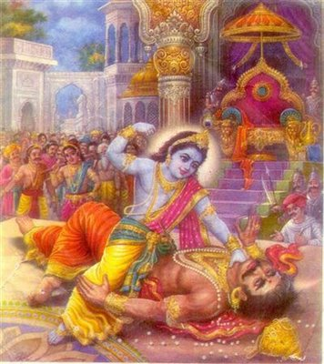
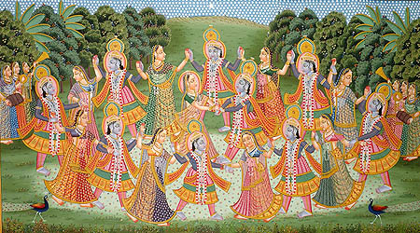
The holy place known as Mathura is spiritually superior to Vaikuntha.
Superior to Mathura is the transcendental forest of Vrndavana because of Krsna’s rasa-lila

Slide 13
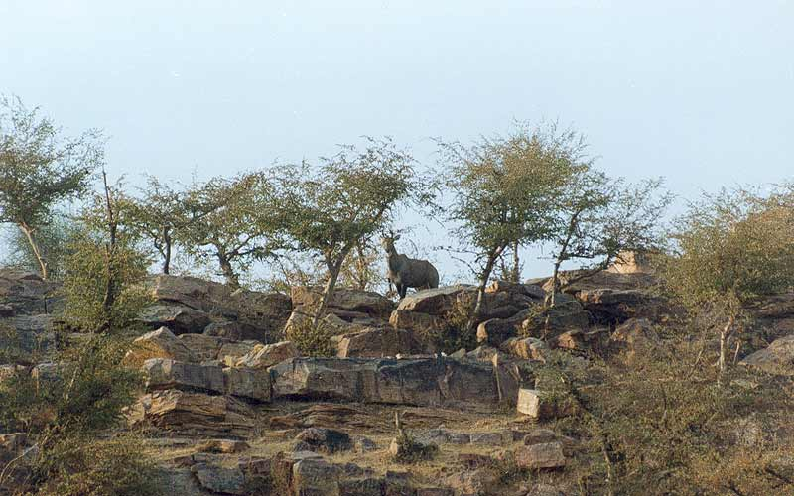
And superior to the forest of Vrndavana is Govardhana Hill, for it was raised by the divine hand of Krsna and was the site of his various loving pastimes.

Slide 14
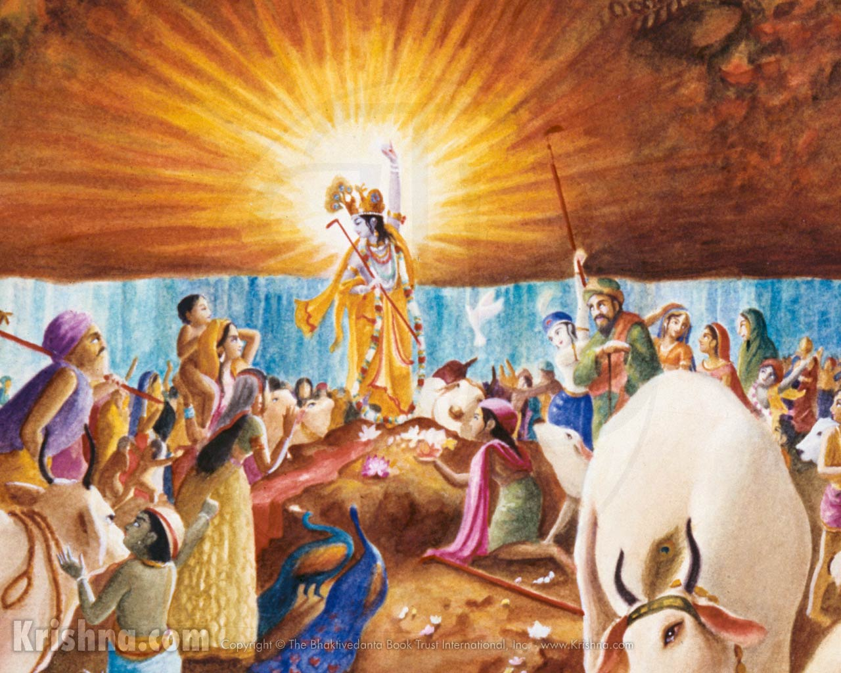

Slide 15
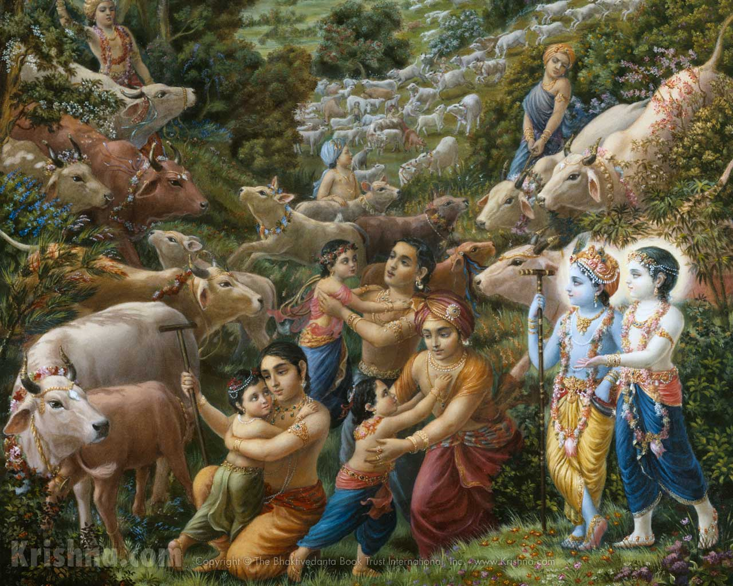

Slide 16
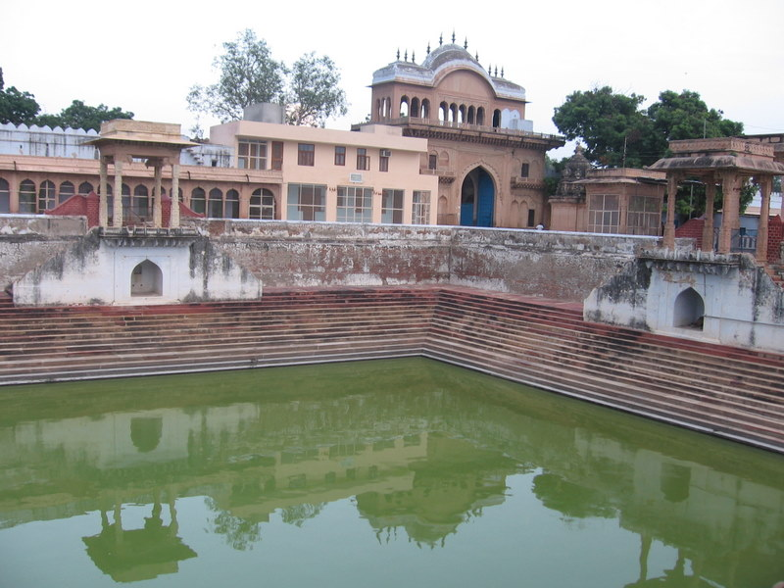
And, above all, the excellent Radha Kunda stands supreme, for it is overflooded with the ambrosia prema of the Krsna.
Where, then, is that intelligent Person who is unwilling to serve this Radha Kunda at the foot of Govardhana Hill?

Slide 17
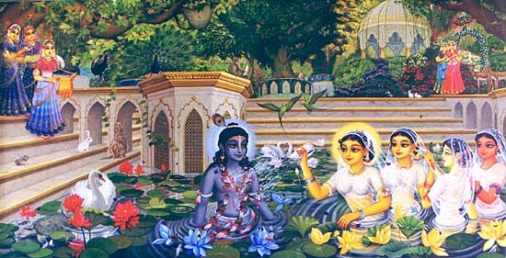

Slide 18
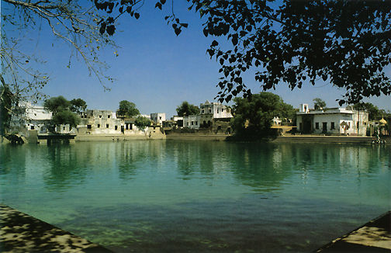
Association, hearing, chanting, worshipping the Lord have been mentioned in the previous verses.
Now living in the Dhama is glorified.

Slide 19
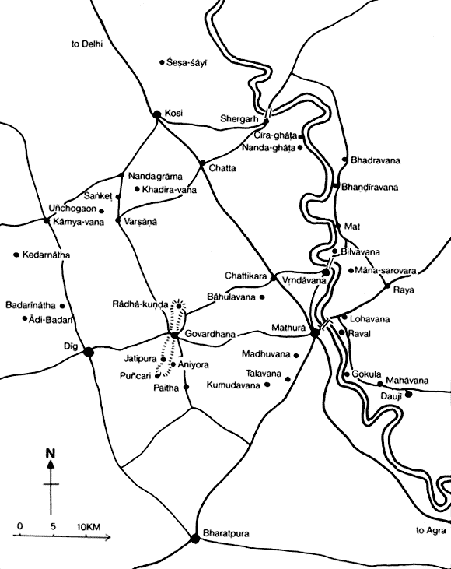

Slide 20
Vaikuntha
Mathura
Vrndavana
Govardhana
Raaha Kunda

Slide 21
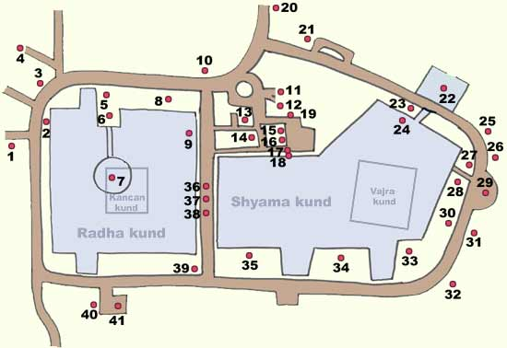

Slide 22
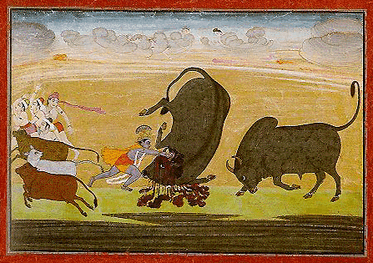

Slide 23
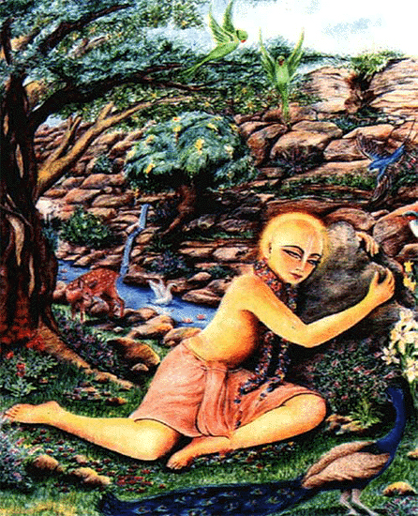

Slide 24
TEXT TEN
karmibhyaù parito hareù priyatayä vyaktià yayur jïäninas
tebhyo jïäna-vimukta-bhakti-paramäù premaika-niñöhäs tataù
tebhyas täù paçu-päla-paìkaja-dåças täbhyo ’pi sä rädhikä
preñöhä tadvad iyaà tadéya-sarasé täà näçrayet kaù kåté

Slide 25
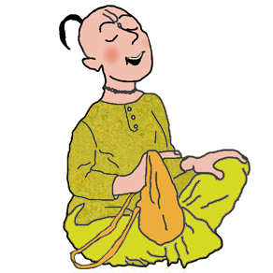
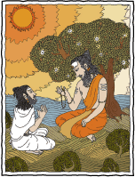
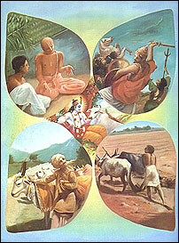
Superior to fruitive workers, the jnani is favored by the Supreme Lord .
Superior to the jnanis are the devotees freed from jnana.

Slide 26
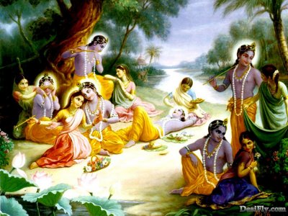
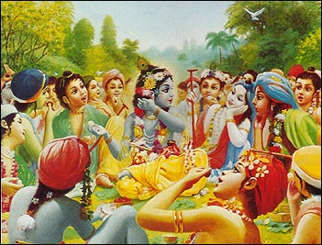
The devotee who has attained prema is superior.
The gopis are the best among the devotees.

Slide 27
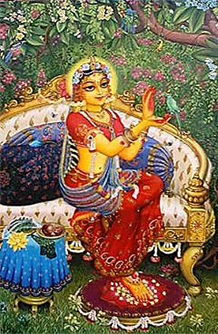
Radha is superior to all the gopis.
Who would not take shelter of her kunda?

Slide 28
Radha
Jnanis
Karmis
Gopis
Bhaktas
Premikas

Slide 29
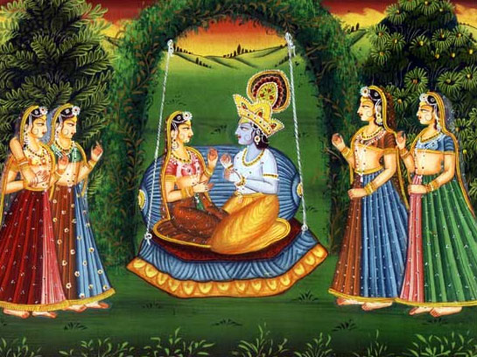
Glorification of Radha

Slide 30
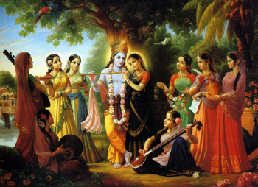
Radha’s Group

Slide 31
TEXT ELEVEN
kåñëasyoccaiù praëaya-vasatiù preyasébhyo ’pi rädhä
kuëòaà cäsyä munibhir abhitas tädåg eva vyadhäyi
yat preñöhair apy alam asulabhaà kià punar bhakti-bhäjäà
tat premedaà sakåd api saraù snätur äviñkaroti

Slide 32
Radha Prema
Of all the lovable gopis, Radha is the dearest.
In every respect, her kunda is described by great sages as similarly dear to him.
That prema is very rarely attained even by the great devotees; therefore it is even more difficult for ordinary devotees to attain.
But if one simply bathes once within those holy waters, one’s prema similar to Radha’s is fully aroused.

Slide 33
Aspiration for her type of Prema
Radha Kunda is non-different from Radha.
It contains her prema.
Association with her kunda will give a person her type of prema.
By doing manasa seva with a siddha deha at this place, while continually chanting, completely inundiated with the water of prema from Radha kunda, the jiva will attain his vastu siddhi at the point of death.

Slide 34
Rati
Prema: remains in spite of causes for its destruction
Sneha: melting of the heart
Mana: anger
Pranaya: intimacy
Raga: intense pranaya, with joy on meeting
Anuraga: experiencing lover in newer and newer ways

Slide 35
Mahabhava; anuraga with sattvika bhavas
  Rudha intense sattvika bhavas
  Adhirudha most intense sattvika bhavas
    Modana
      Mohana in separation
        Divyonmada
    Madana continuously present in Radha, giving life to all bhavas.

Slide 36
Rati
Prema Dasya rasa
Sneha Sakhya Rasa
Raga Vatsalya Rasa
Mana Madhurya Rasa
Pranaya
Anuraga Gopis, not queens in Dvaraka
Mahabhava Gopis, not queens in Dvaraka
  Rudha
  Adhirudha
    Modana
    Madana Radha

Slide 37
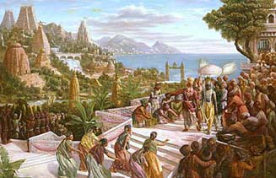

Slide 38
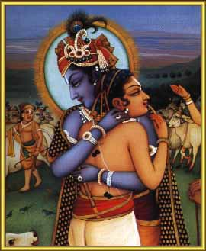

Slide 39
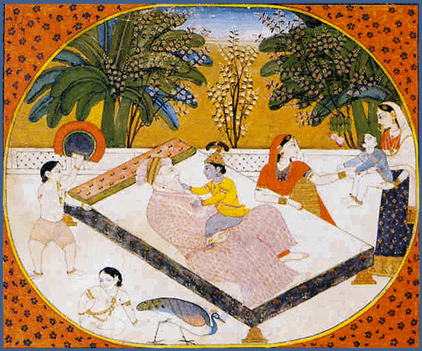

Slide 40
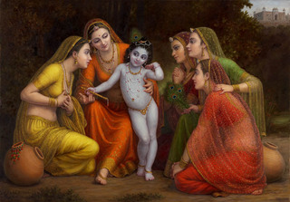

Slide 41
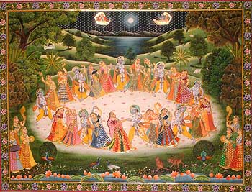

Slide 42
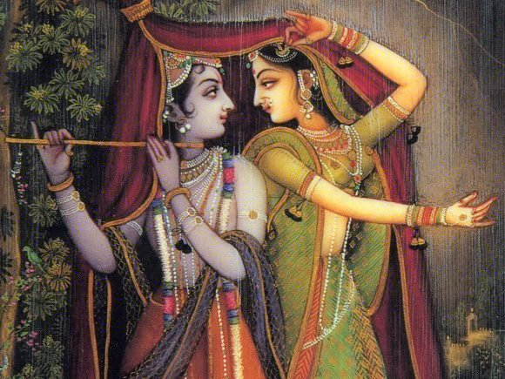

Slide 43
